Slide 1


Virtual Biopsy: Predicting Lung Cancer Biomarkers with AI

Slide 2
Clinical Problem
In clinical practice, biomarkers are usually determined from pathology/immunohistochemistry.
Our goal is to explore whether we can predict these biomarkers directly from lung CT scans, using AI, as a non-invasive supporting signal.

Slide 3
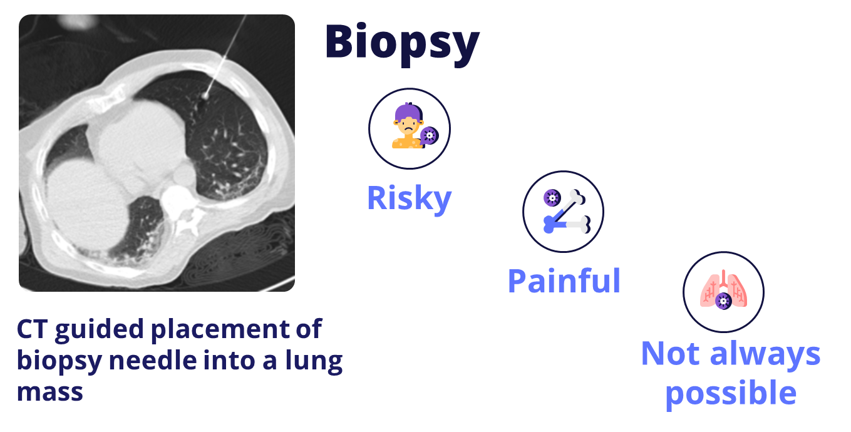

Slide 4
Radiomics IHC Biomarker System

Slide 5
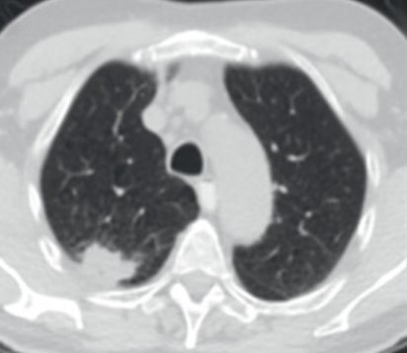
Our Solution
An AI system that predicts key lung cancer biomarkers directly from CT
Non-invasive biomarker estimation
Works directly on standard CT scans
Designed as a clinical decision support tool

Slide 6
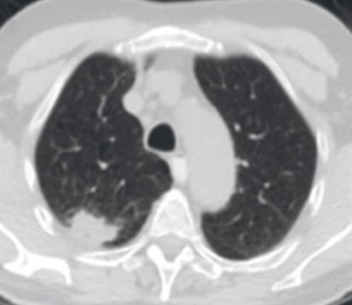
Pipeline
CT
Lung Segmentation
Extract Image Features
Radiomics
Predict Biomarkers

Slide 7
Model
Flow
Architecture
AI-based analysis of lung CT scans
Combines image patterns with quantitative features (radiomics)
Outputs probabilities for TTF1 and CK7
A volumetric image analysis component
A numerical feature analysis component
A fusion step for final prediction

Slide 8
Results
3D Model
2D Model
3D model analyzes the full CT volume at patient level
Better performance for CK7 biomarker
Accuracy:
TTF1: 66.67%
CK7: 88.89%
Pretrained features help with small datasets
Stable performance across both biomarkers
Accuracy:
TTF1: 77.78%
CK7: 77.78%

Slide 9
Comparison
The 3D model benefits from analyzing the entire CT volume, capturing global spatial patterns
The 2D model achieves comparable accuracy by aggregating information from multiple informative slices

Slide 10

Market Overview
Primary users: Radiologists + hospital decision makers
﻿﻿Where: High-CT volume hospitals & screening programs
﻿﻿Early regions: US/Canada + EU oncology hubs
﻿﻿Growth path: Rural/teleradiology via cloud deployment
Notes:
Our product is an AI assistant for chest CT that helps radiologists spot suspicious areas faster and reduce missed findings. The market we operate in is medical imaging software, specifically radiology workflows and lung screening / oncology-related CT reading. Our customers are primarily radiology departments and hospital/clinic decision makers (medical directors, imaging managers, procurement/IT). The end-user is the radiologist, but the buyer is the institution—so this is clearly B2B, with patient benefit as an indirect outcome.

Slide 11
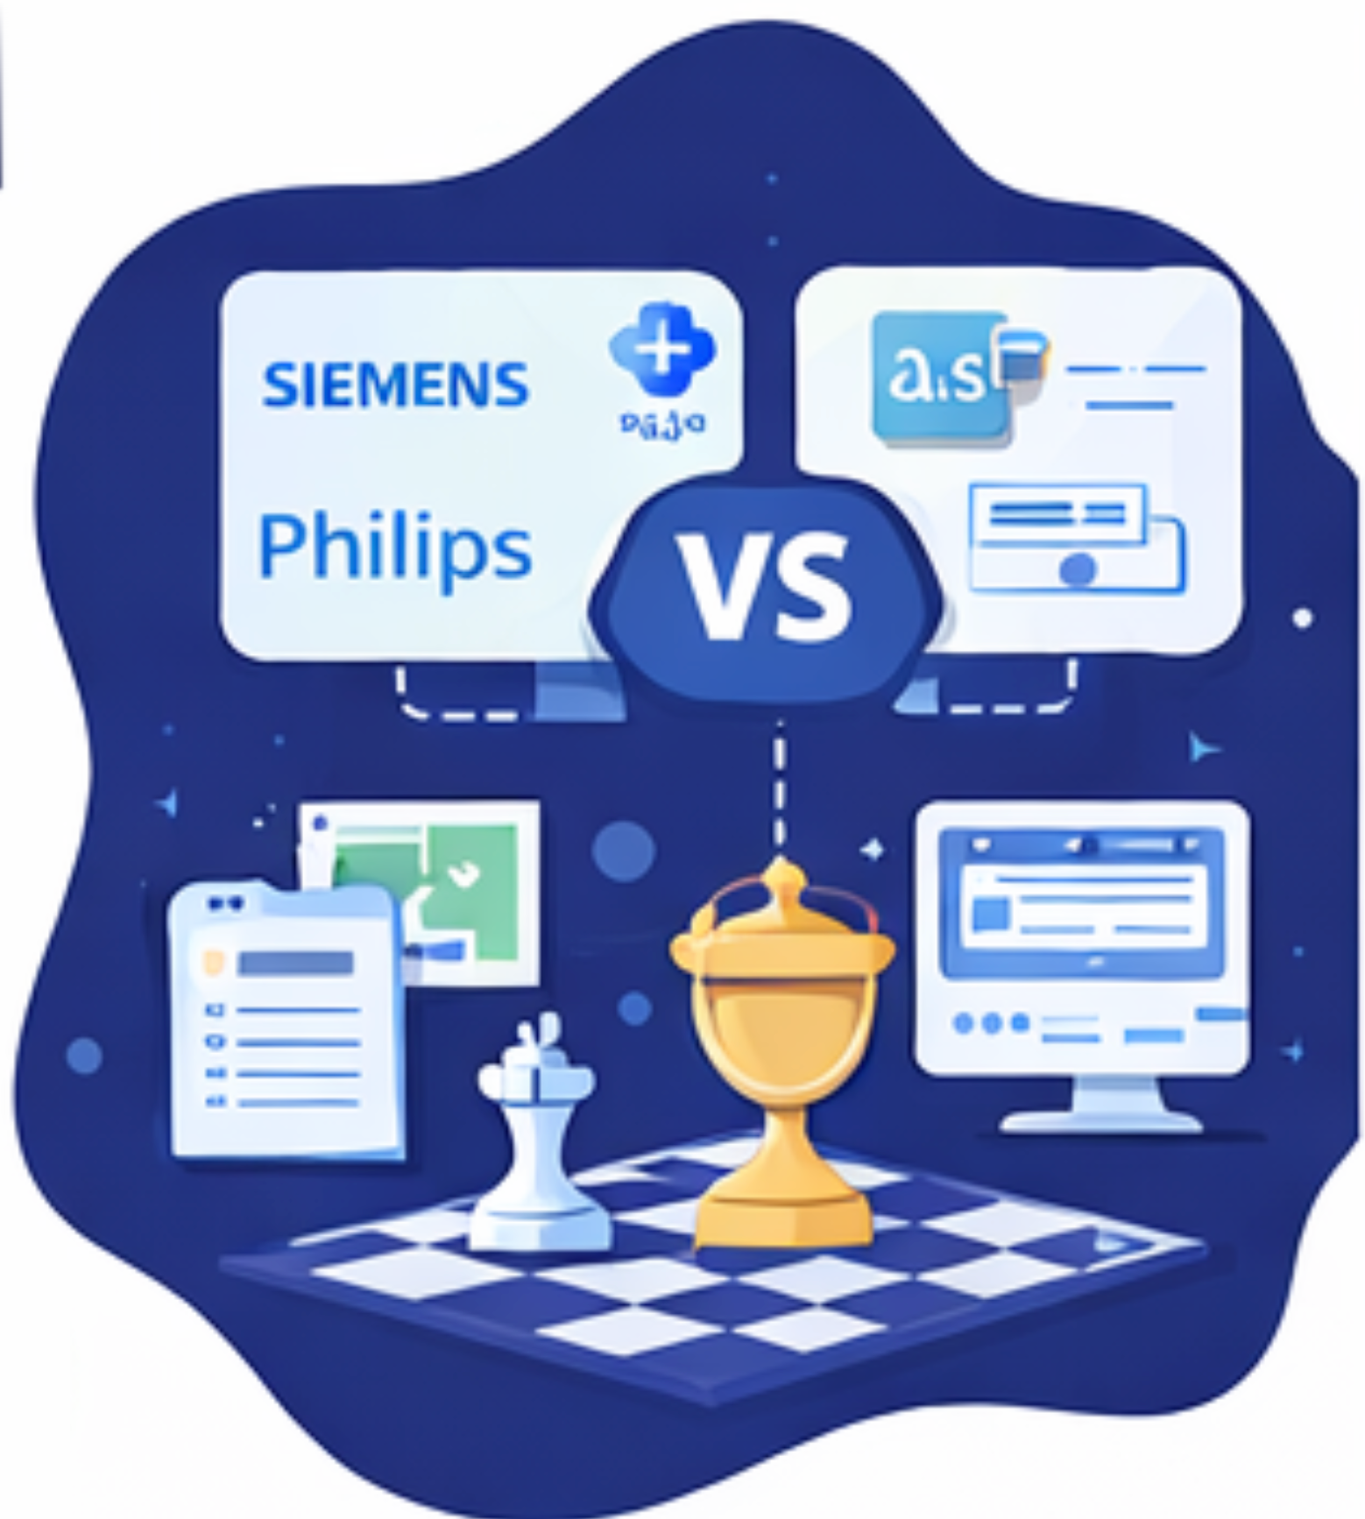
Competitive Landscape
Key players: Siemens, Philips, Medtronic
﻿﻿Substitutes: PACS tools + manual tracking / open-source workflows
﻿﻿Industry needs: Integration + validation + compliance
practical clinical value
with low switching friction
Notes:
We compete with two alternatives: big imaging vendors with complex, slow-to-deploy solutions, and substitutes like PACS + manual tracking or open-source tools that cost time and effort.
We differentiate with three things: easy integration into existing workflow, faster reading/prioritization, and more trust through clearer, easier-to-interpret results. In short: practical clinical value with low switching friction

Slide 12

Value Proposition
﻿﻿Fewer misses: highlight suspicious nodules
Faster reads: shorter time per chest CT
﻿More confidence: explainability (not a black box)
Fits workflow: viewer + export / report + audit trail
Notes:
“Our final value proposition, in one clear non-technical sentence, is:
‘In minutes, we highlight what matters on a chest CT—so radiologists miss fewer critical findings and report faster.’
If we split it by audience:
B2B (hospitals/clinics): ‘Reduce reporting time and missed findings, increasing radiology throughput and quality.’
Patient impact (indirect): ‘Earlier detection and fewer unnecessary follow-up procedures.’”

Slide 13
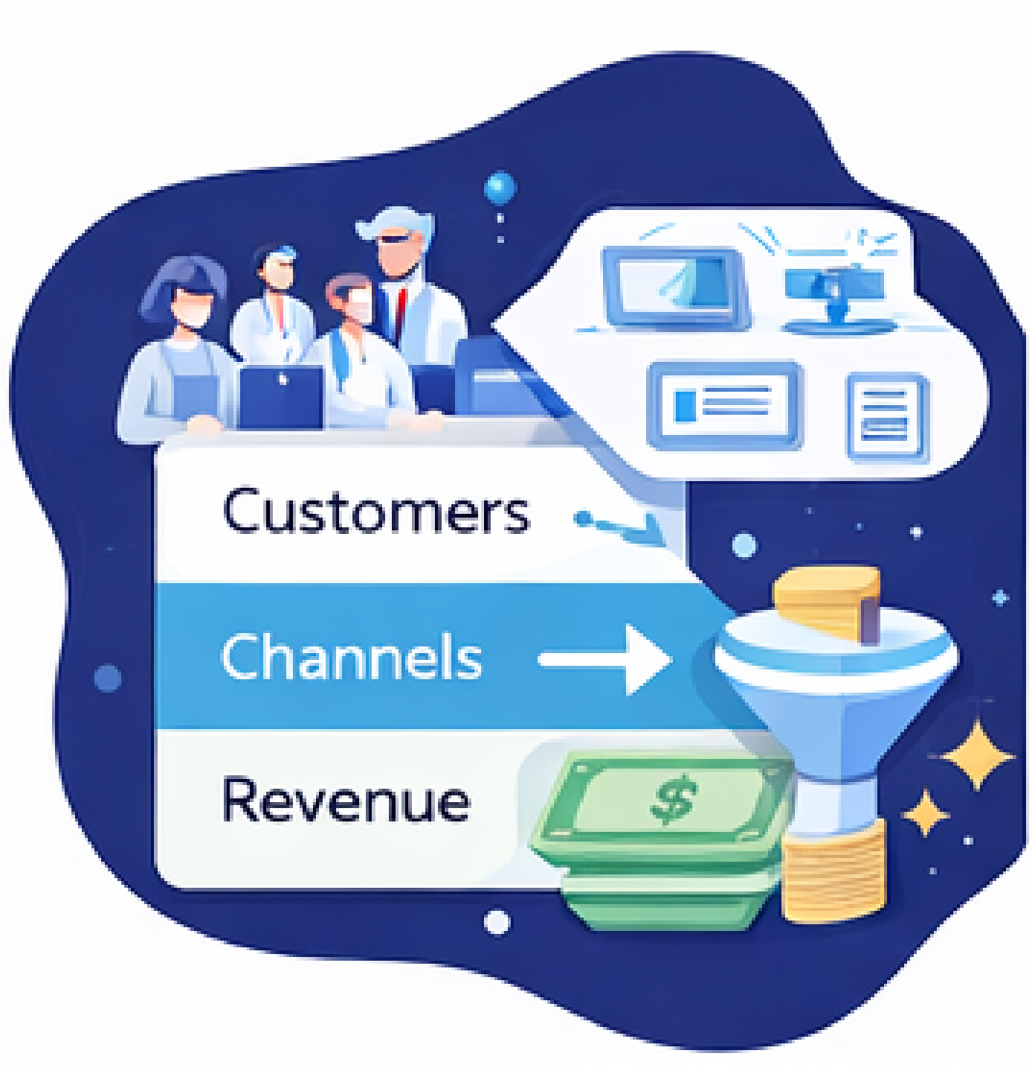
Business Model
Customers: Radiology depts, cancer centers, teleradiology
Revenue: Subscription + setup / integration fees
Customer relationship: Onboarding + training/support packages
Key partners: Pilot hospitals (validation), medical advisors (credibility), PACS/RIS/EHR integration partners (on-prem deployment)
Notes:
Our business model is B2B SaaS:
A recurring subscription per hospital/clinic site or radiology department (tiered by scan volume or users)
A one-time setup & integration fee
Optional training and consulting for onboarding and workflow optimization
This creates predictable recurring revenue, with integration and services as additional income, and it fits well into a Business Model Canvas (clear customers, clear value, and ongoing support relationships).

Slide 14
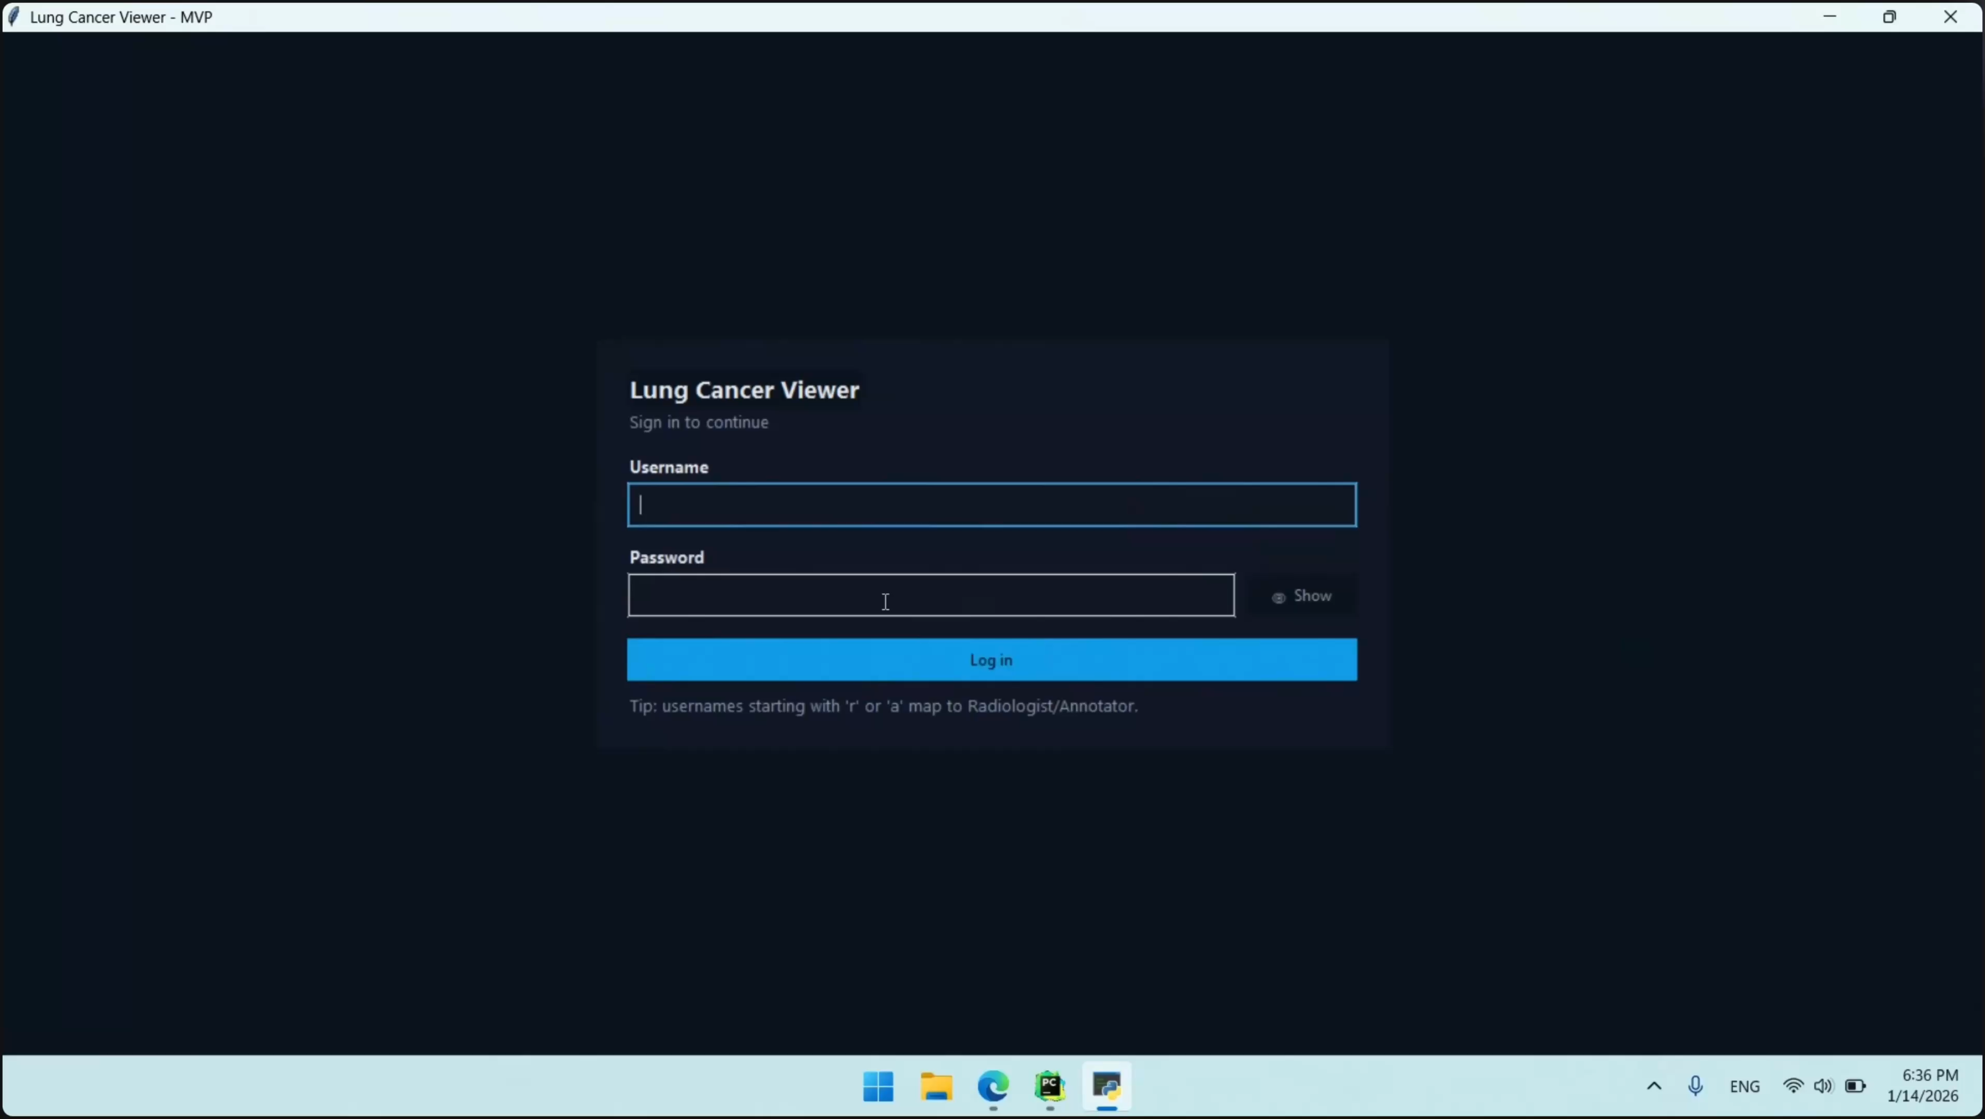

Slide 15
Thank You!
Team:
Pulpă Bianca Gabriela
Pușcaș Alexandra Cristina
Rebeleș Bogdan Călin Florin
Pușcaș Darius Nicolae
Tiut Cristian
Ursoiu Călin Alexandru

